Slide 1
LITERATURE SURVEY
A Study on Sixth Sense Technology (ISSN 2229-5518)
A tool that connects the physical world with the digital world or the world or data.
This wearable device has the capability of turning everything to touch screen just by capturing the gestures of a person.
For orders face recognition technique is used algorithms with the sixth sense method.
The methodology used is based on the sixth sense technology where the user will be able to move the cursor by the movement of fingers.

Slide 2
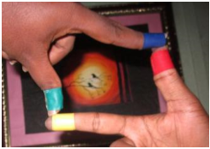
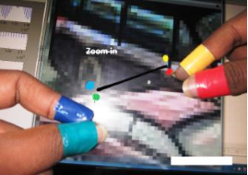
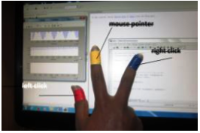
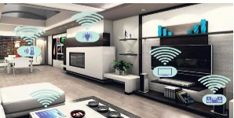
APPLICATIONS
Taking Pictures:
Moving Mouse Pointer using Fingers :
Resizing of Images:
Home Automation:

